Slide 1
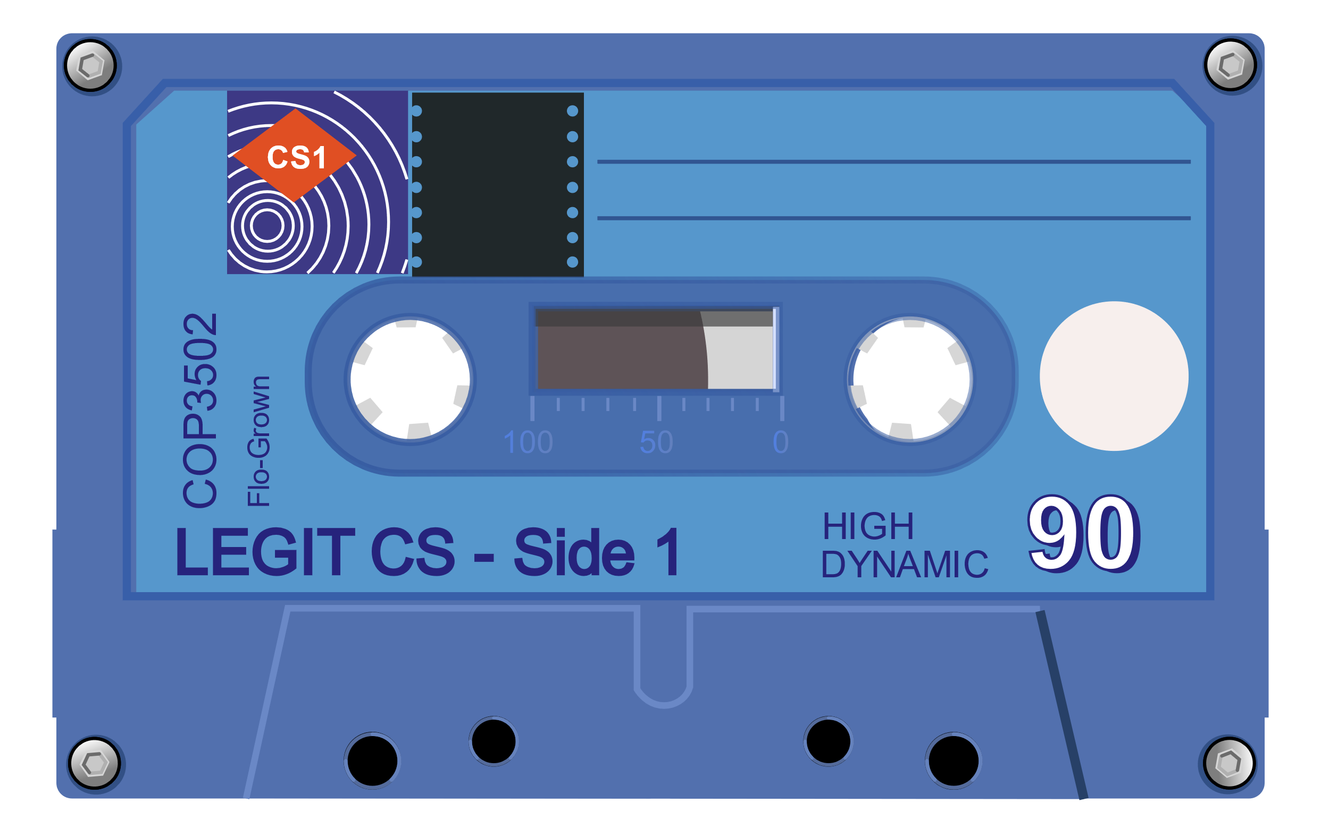
Data Types
“Data! Data! Data! I can’t make bricks without clay!”
– Sir Arthur Conan Doyle

Slide 2
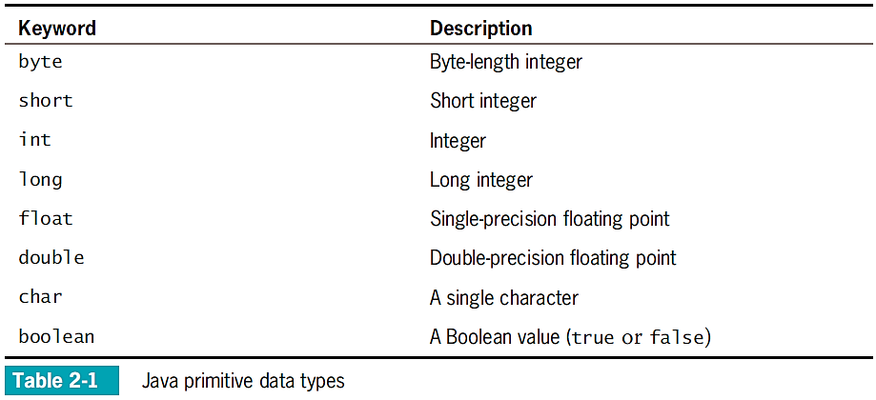
Review
Integer types
byte – 8 bits (-128 to 127)
short – 16 bits (-32,768 to 32,767)
int – 32 bits (-2,147,483,648 to 2,147,483,647)
long – 64 bits (~-9 quintillion to ~9 quintillion)
Floating-point (floating radix) types (Value + Exponent)
Have exponent, sign, and value
float – 32 bits (IEEE standard)
double – 64 bits (IEEE standard)
Character type
Represents a single character
char – 16 bits (Java specific!)

Slide 3
Compound Arithmetic Operators
We can use compound arithmetic operators to combine assignment and operations:
01 02 03 04 05
int meeces = 10;
int mice = 20;
meeces += mice; // meeces = meeces + mice; -> 30
mice /= 2; // mice = mice / 2; -> 10

Slide 4
Increment & Decrement
Most languages (and CPUs) have dedicated increment and decrement operators:
05 06 07 08 09 10 11 12 13 14 15
int numBananas = 2;
numBananas++;
while (numBananas > 0)
{
System.out.print("There are " + numBananas + " bananas. ");
numBananas--;
}
System.out.println("Yes, we have " + numBananas++ + " bananas.");
System.out.println("Now we have " + ++numBananas + " bananas.");
Values
numBananas
Increment
Decrement
3
2
1
0
OUTPUT:
Post-increment
There are 3 bananas.
There are 2 bananas.
There are 1 bananas.
Yes, we have 0 bananas.
Now we have 2 bananas.
Pre-increment

Slide 5
Floating Point, Revisited
Floating point numbers give us better precision, but sometimes lower accuracy:
01 02 03 04 05 06 07 08 09 10 11 12 13 14 15
public class AllTheThings
{
public static void main(String[] args)
{
float myLulz = 0.7f;
float yourLulz = 0.4f;
float lolDiff = myLulz – yourLulz;
lolDiff –= 0.3f;
if (lolDiff == 0)
System.out.println("SOMEONE TOOK ALL THE THINGS!");
else
System.out.println("Difference of the lulz is " + lolDiff);
}
}
0.6999999999999999555910790
0.4000000000000000222044605
0.2999999999999999888977697
Not zero!
OUTPUT:
Difference of the lulz is -2.9802322E-8.

Slide 6
Floating Point Comparison
To catch edge cases, define a delta value (buffer) for comparisons:
01 02 03 04 05 06 07 08 09 10 11 12 13 14 15
public class AllTheThings
{
public static void main(String[] args)
{
float myLulz = 0.7f;
float yourLulz = 0.4f;
float lolDiff = myLulz – yourLulz;
lolDiff = lolDiff – 0.3f;
if (lolDiff < 0.00001)
System.out.println("SOMEONE TOOK ALL THE THINGS!");
else
System.out.println("Difference of the lulz is " + lolDiff);
}
}
Delta value
OUTPUT:
SOMEONE TOOK ALL THE THINGS!

Slide 7
Integer OverFlow / UnderFlow
When integer numbers go too high / low, we can experience overflow and underflow:
01 02 03 04 05 06 07 08 09 10 11 12 13 14 15
import java.util.Scanner;
public class GoWithTheFlow
{
public static void main(String[] args)
{
short numCatPictures = 32725;
Scanner myScanner = new Scanner(System.in);
System.out.print("Starting with " + numCatPictures + " cat pictures. How many new ones are there? ");
numCatPictures += myScanner.nextInt();
System.out.print("We now have " + numCatPictures + ". How many were pruned out of the collection? ");
numCatPictures -= myScanner.nextInt();
System.out.println("Terminating with " + numCatPictures + " pictures of cats.");
}
}
OUTPUT:
100
Starting with 32725 cat pictures. How many new ones are there?
We now have -32711 . How many were pruned out of the collection?
Terminating with 32425 pictures of cats.
400

Slide 8
Boolean Variables
We can store truth values using a boolean type:
05 06 07 08 09 10 11 12 13 14 15 16 17 18 19 20 21 22 23
public static void main(String[] args)
{
System.out.println("Try to guess my number (0-100)!");
Scanner myScanner = new Scanner(System.in);
int magicNumber = (int) Math.round(Math.random() * 100.0);
boolean hasFoundAnswer = false;
while (!hasFoundAnswer)
{
System.out.print("What’s your guess? ");
int guess = myScanner.nextInt();
if (guess != magicNumber)
System.out.println("Nope. Try again!");
else
hasFoundAnswer = true;
}
System.out.println("Thanks for playing!");
}
OUTPUT:
Try to guess my number (1-100)!
What's your guess? 15
Nope. Try again!
What's your guess? 37
Nope. Try again!
What’s your guess? 42
Thanks for playing!

Slide 9
Characters
A character is a single symbol (letters, numbers, punctuation, etc.):
01 02 03
char letter = 'B';
char digit = '2';
System.out.println("The ID for this Morty is " + letter + digit + ".");
character literal
OUTPUT:
The ID for this Morty is B2.
Character specific methods can also be helpful:
Function | Description | Example | Value
isDigit(char) | true if char is [0-9] | Character.isDigit('a') | false
isLetter(char) | true if char is [a-z,A-Z] | Character.isLetter('q') | true
isWhitespace(char) | true if char is whitespace | Character.isWhitespace('\t') | true
toUpperCase(char) | returns uppercase of letter | Character.toUpperCase('j') | 'J'
toLowerCase(char) | returns lowercase of letter | Character.toLowerCase('Z') | 'z'

Slide 10
Primitive Wrappers
Every primitive type has a wrapper that gives us extra functionality.
Type | Wrapper
byte | Byte
short | Short
int | Integer
long | Long
float | Float
double | Double
boolean | Boolean
char | Character
void | Void**
Static Method | Description
int highestOneBit(int) | Leftmost bit’s value
int lowestOneBit(int) | Rightmost bit’s value
int reverse(int) | Reverse bits in binary
int rotateLeft(int) | Rotate bits to left
int rotateRight(int) | Rotate bits to right
int parseInt(String) | String to int
int signum(int) | -1, 0, or 1 (based on sign)
String toBinaryString(int) | int to binary String
String toHexString(int) | int to hexadecimal String

Slide 11
Constant Values
Sometimes we have values that never need to change. These constants can be handled more efficiently (and safely) if we tell the compiler:
01 02 03 04 05 06 07 08 09 10 11 12 13 14 15
import java.util.Scanner;
public class LightNanosecondCalculator
{
public static void main(String[] args)
{
final double LIGHT_NANOSECOND_M = 299792458.0 / 1000000000.0;
final double M_PER_FT = 0.3048;
System.out.print("What is your height in feet?");
Scanner myScanner = new Scanner(System.in);
double height = myScanner.nextDouble() * M_PER_FT / LIGHT_NANOSECOND_M;
System.out.println("You are " + height + " light-nanoseconds tall!");
}
}
OUTPUT:
5.5
What is your height in feet?
You are 5.59186849 light-nanoseconds tall!

Slide 12


Constant Values
Once declared, constants cannot be changed!
01 02 03 04 05 06 07 08
public class WhatNotToDo
{
public static void main(String[] args)
{
final double LIGHT_NANOSECOND_M = 299792458;
LIGHT_NANOSECOND_M /= 1000000000;
}
}
Compiler

Slide 13
Type Conversion - Implicit
Java (and most languages) can implicitly convert between many basic types, depending on the operation and types involved:
01 02 03 04 05 06 07 08 09
public class YouWillBeConverted
{
public static void main(String[] args)
{
final double TAU = Math.PI * 2;
System.out.println("Tau's value is " + TAU);
}
}
Assignment right type → left type
Arithmetic integer → floating pt.
String Concatenation other type → String
OUTPUT:
Tau's value is 6.283185307179586

Slide 14
Type Conversion - Explicit
We can explicitly convert types –known as type casting:
01 02 03 04 05 06 07 08 09 10 11
public class YouWillBeConverted
{
public static void main(String[] args)
{
final double TAU = Math.PI * (double) 2;
final double TWO_TAU = TAU * 2.0;
System.out.println("Double double-tau: " + TWO_TAU);
System.out.println("Integer double-tau: " + (int) TWO_TAU);
}
}
Integer → Floating Point Perfect conversion
Floating Point → Integer
Possible information loss
OUTPUT:
Double double-tau: 12.566370614359172
Integer double-tau: 12

Slide 15
Binary Representation
Computers use binary for all data.
Numbers are stored using binary numbering:
Characters are stored as numbers which represent their symbols:
Bit | Val.
0 | 1
1 | 2
2 | 4
3 | 8
4 | 16
5 | 32
6 | 64
7 | -128
A
B
Z
a
z
↵
!
65
66
90
97
122
13
33
01000001
01000010
01011010
01100001
01111010
00001101
00100001
73
01001001
64 + 8 + 1

Slide 16
Octal and Hexidecimal
Octal (base-8, 3b) and hexadecimal (base-16, 4b) are frequently used in programming:
Octal
Hexidecimal
00000001
00000010
00011010
00100001
00111010
00001110
00010001
001
002
032
041
072
016
021
1
2
26
33
58
14
17
01000001
01000010
01011010
01100001
01111010
00001101
00100001
0x41
0x42
0x5A
0x61
0x7A
0x0D
0x21
65
66
90
97
122
13
33
A
B
Z
a
z
↵
!
By convention, octal is prefixed with ‘0’, while hex is prefixed with ‘0x’.
Binary numbers are prefixed with ‘0b’.

